Slide 1
Logistic Regression and ANN Solutions for Churn Rate
1
Contributors: Jason Spaw

Slide 2
Objective:
2
Assess the potential losses due to churn.
Provide solutions for churn rate.
Observe potential modeling for predicting churn of customers in a given time period.
Logistic Regression
ANN

Slide 3

What is churn rate, and why is this important?
3
Churn Rate: The percentage of customers or subscribers that stop doing business with a company over a specific period of time.
Importance:
Banks make their money off
loans and other services
provided to existing customers.
Free checking accounts act as
an initial relationship between
banks and customers.
Losing customers means losing from your pool of sales, or potential leads.

Slide 4
Other Key Terms
4
Net Churn Rate: The measure of lost revenue month over month,due to cancellations and account downgrades, after factoring in revenue from existing customers.
Expansion Revenue: Any revenue that is generated in excess from customer’s initial purchasing price or contact.
Churned Revenue: Measure the monthly recurring revenue (MRR) loss from existing customers over a specific period.
ARPA: Average Revenue Per Account (assuming stock market annual returns of 10% for this example)

Slide 5
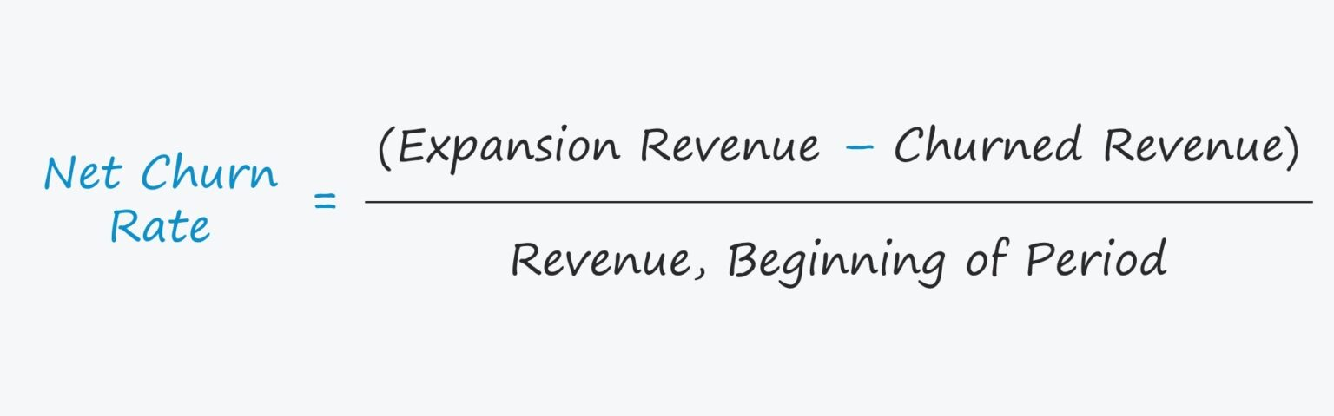
Net Churn Rate
5
Expansion Revenue = Assume no excess profits
Churned Revenue = (Capital in active churned accounts) * (Average rate of return (10%))
Revenue, Beginning of Period = (Capital in active accounts) * (Average rate of return (10%))

Slide 6
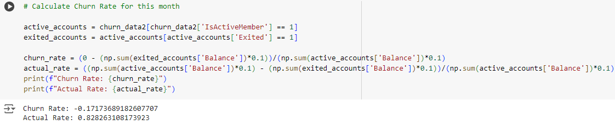
Your Estimated Net Churn Rate
6

Slide 7
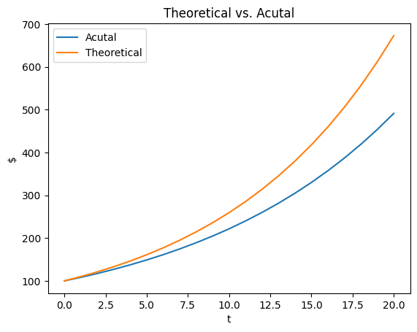
Theoretical vs. Actual Growth Over Time
7

Slide 8
Other Products Missed Due to Churn
8
Loans
Monthly Maintenance Fees
Overdraft Fees
Insufficient Funds Fees
Out-of-network ATM Fees

Slide 9

Our Solution
9
Provide you with a model that effectively predicts churn rate for the given month.
This provides target customers
Bank may provide incentives to target customers to keep them.
Incentives may include lower interest rates
This enables you to keep legacy customers on higher interest rates while only targeting those at risk of churning to provide lower rates for retention.
Optimize profits

Slide 10
Cleaning and Feature Engineering
No NaN’s present
Gender column was converted to binary (Male = 1, Female = 0)
Geography was split into dummy columns reflecting each individual country
Data was normalized

Slide 11
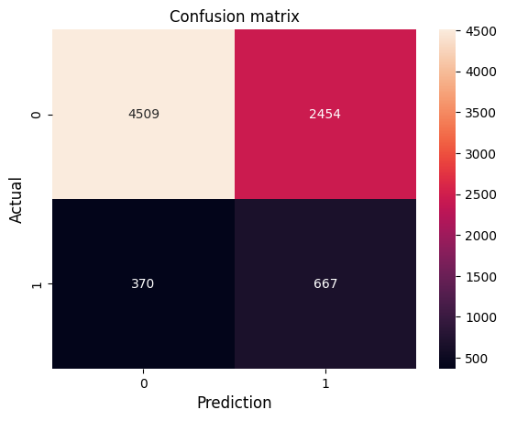
Model Performance
10
Logistic Regression
Accuracy: 0.6470
Precision = TP/(TP + FP) = 0.214
Recall = TP/(TP + FN) = 0.643

Slide 12
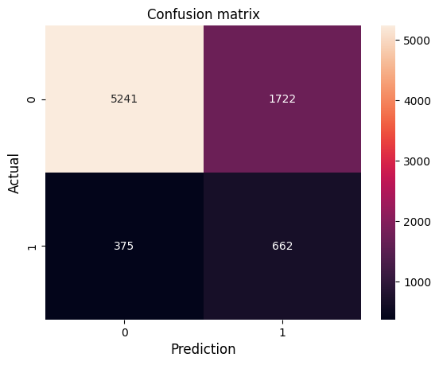
Model Performance
11
Shallow ANN (neurons = 14)
Accuracy: 0.738
Precision = TP/(TP + FP) = 0.278
Recall = TP/(TP + FN) = 0.638

Slide 13
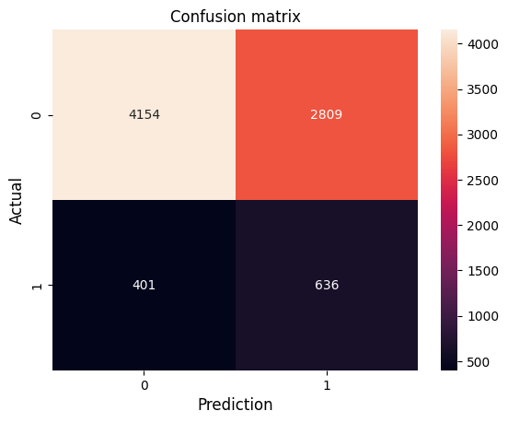
Model Performance
12
ANN Classifier
architecture=[20,16,14],
activations=[sigmoid, np.tanh, sigmoid]
Accuracy: 0.599
Precision = TP/(TP + FP) = 0.185
Recall = TP/(TP + FN) = 0.613

Slide 14
Conclusion
13
Churning of customers accounts for noticeable losses in the company
Solutions:
Churn Predictor
Incentives (possibly lower interest rates)
Will optimize the retention efforts by minimizing resources (profits) used to retain
All models performed similarly but Shallow ANN had better precision and recall, with recall being our greatest concern.

Slide 15
14
Questions?

Slide 16
15
Thank You

